Slide 1
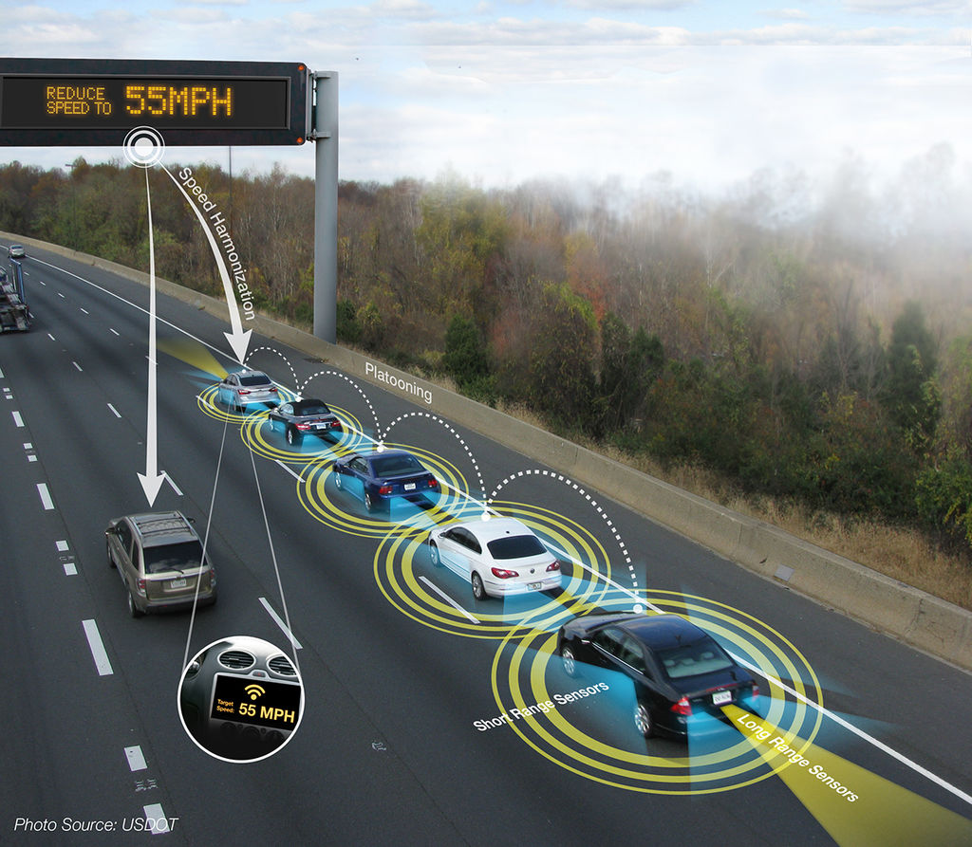
Fuzzy Logic Longitudinal Controller
Heath Palmer | 1/18/2023
Notes:
Source: https://en.wikipedia.org/wiki/Platoon_(automobile)

Slide 2
Progress Update
Updated FIS during highway cruise condition.
Increased the length of the highway and thus the overall simulation duration.
Over time, the gap error gets closer to zero for each following vehicle.
Recorded how the FIS performs during slow down conditions.
Lead vehicle slows the leading human driven vehicle down 30mph for 90 seconds.
The lead vehicle then speeds back up to max speed over 60 seconds.
Spoke with Anoop on 1/13/23 and brainstormed the GA parameters and fitness function.
Planning to tune the triangle membership function parameters including the peak and two edge locations.
The fitness function will be the sum of the gap error while the FIS is in control of the following vehicles.

Slide 3
SUMO – FIS Controlled Vehicles
The Fuzzy inference system (FIS) is implemented after 300-time steps into the SUMO simulation.
Vehicle 0 is using the human driving model the entire time. Vehicles 1-4 use the longitudinal FIS after time step 300.
The inclusion of the FIS slows down the simulation considerably.
The current hand-picked membership functions and rules appear to perform better than human driving model (Krauss model) with decrease in the gap distance.

Slide 4
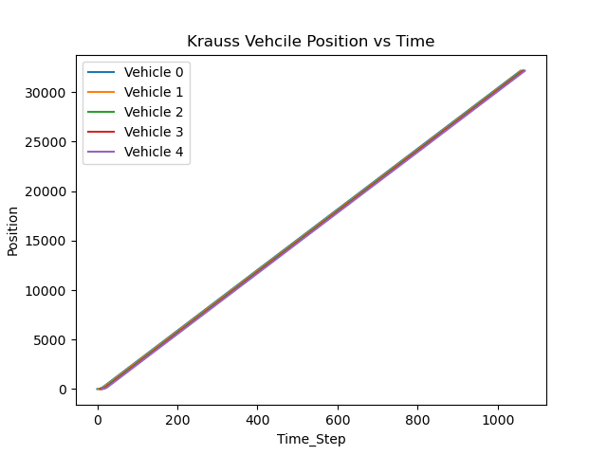
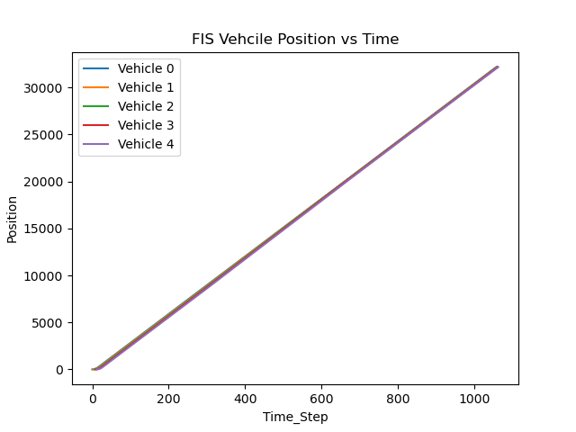
Krauss vs FIS – Position (meters)
Review the position after time step 300.

Slide 5
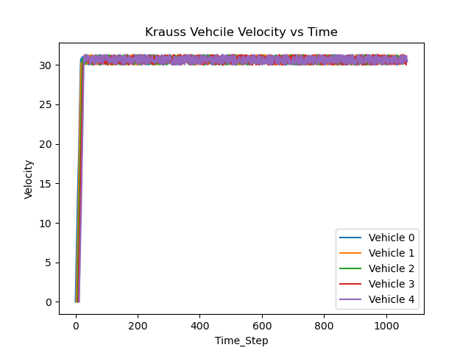
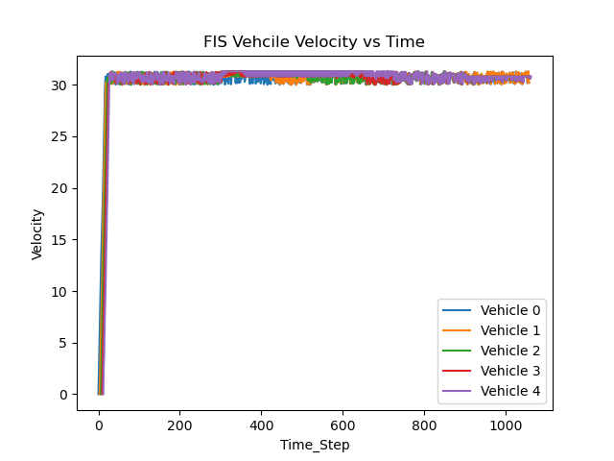
Krauss vs FIS – Velocity (m/s)
Review the velocity after time step 300.

Slide 6
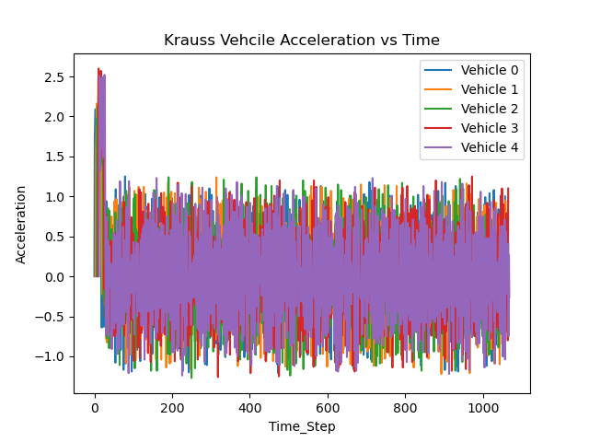
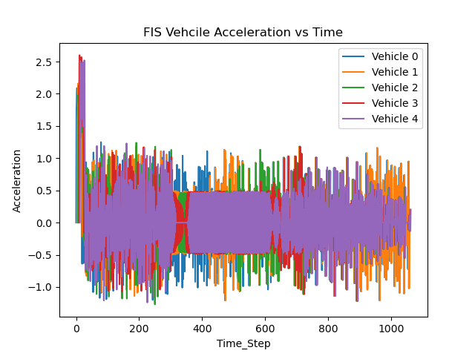
Krauss vs FIS – Acceleration (m/s^2)
Review the acceleration after time step 300.

Slide 7
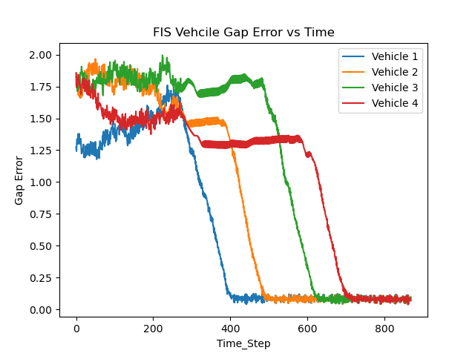
FIS Gap Error (seconds)
The ideal gap is 1 second.
The gap error is the: ego vehicle gap – ideal gap
The best gap error is closest to 0. The hand-picked membership functions and rules require tuning.

Slide 8
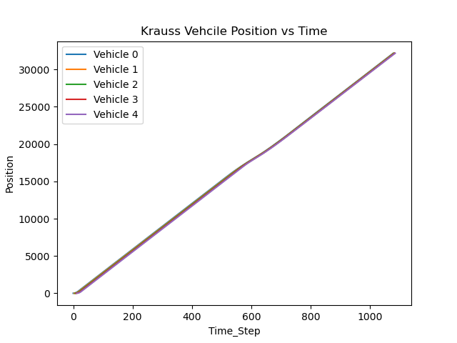
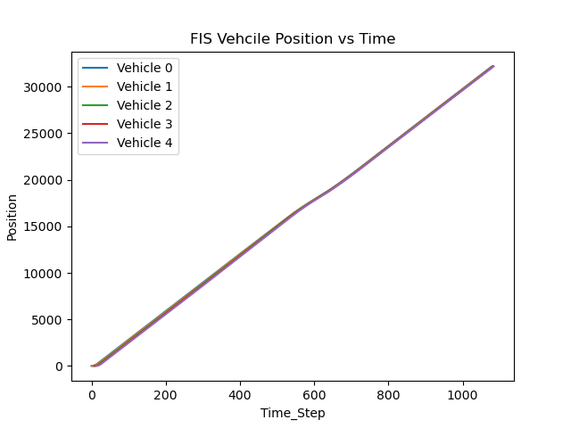
Krauss vs FIS – Position (meters)
Lead vehicle speed decreased by 30 mph between timestep 525 and 615.

Slide 9
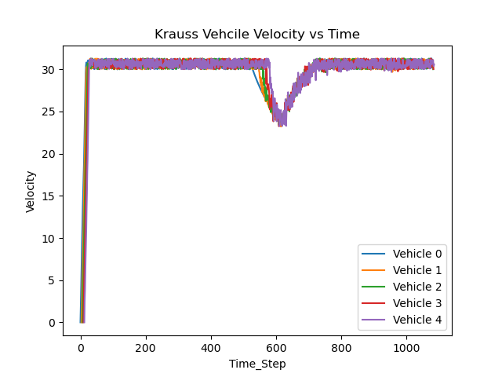
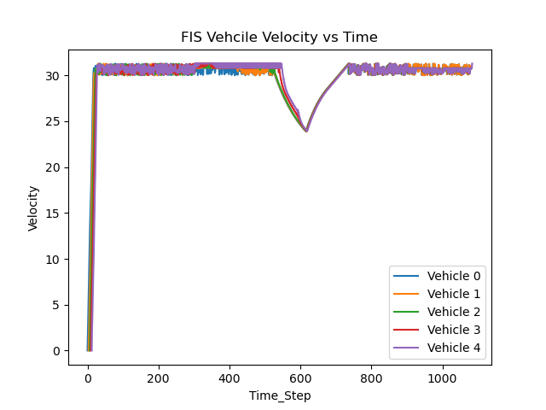
Krauss vs FIS – Velocity (m/s)
Lead vehicle speed decreased by 30 mph between timestep 525 and 615.

Slide 10
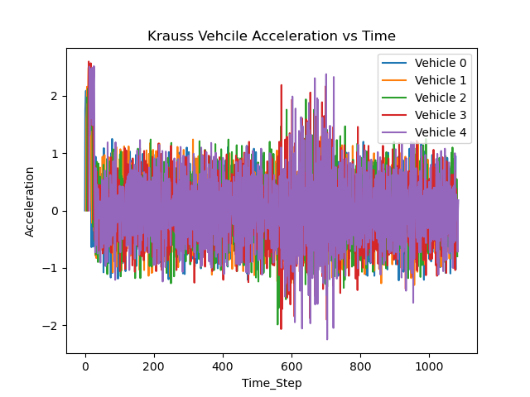
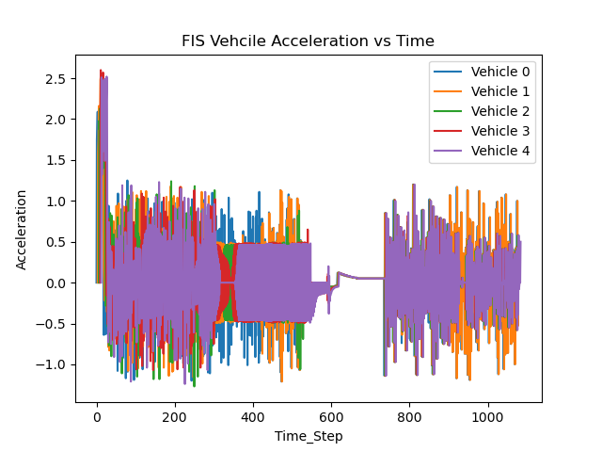
Krauss vs FIS – Acceleration (m/s^2)
Lead vehicle speed decreased by 30 mph between timestep 525 and 615.

Slide 11
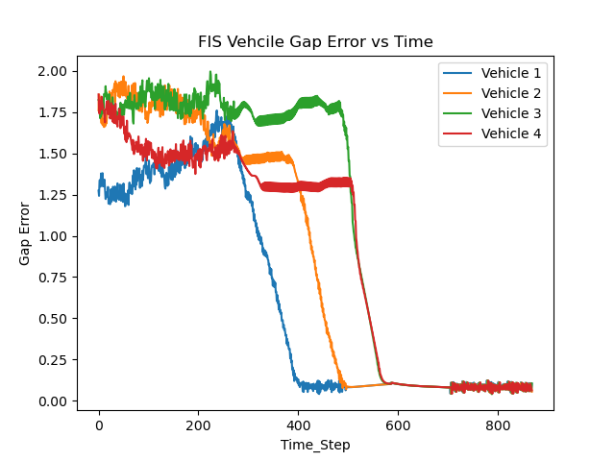
FIS Gap Error (seconds)
Lead vehicle speed decreased by 30 mph between timestep 525 and 615.
The ideal gap is 1 second.
The gap error is the: ego vehicle gap – ideal gap
The best gap error is closest to 0. The hand-picked membership functions and rules require tuning.

Slide 12
Immediate Next Steps
Implement a genetic algorithm to tune the FL controller

